Slide 1
Electricity demand and price forecasting
Presented By – Prabhat Kumar Nayak
Email- prabhat123dkl@gmail.com

Slide 2
Problem Statement
Develop models to forecast hourly electricity demand, considering influencing factors like weather, time of day, and weekdays.
Implement models to predict electricity prices, accounting for market dynamics and external variables.
Compare the performance of various models (Linear Regression, Decision Trees, Random Forests, Gradient Boosting, LSTM) using metrics such as MAPE, R², and RMSE.
Provide insights to optimize utility operations, reduce costs, and enhance energy distribution efficiency.

Slide 3
Contents
Problem Statement
Data Introduction
Exploratory data analysis
Feature Engineering
Model Implementation
Model Comparison & Selection
Conclusion

Slide 4
Data Introduction
This is a time series forecasting problem where two distinct datasets of energy and weather data are used. The energy consumption and weather data from various cities in Spain are combined to create a multivariate time series forecasting problem .
Energy Generation Data (energy_dataset.xlxs):
Weather Features (weather_features.xlxs)
Contains historical data on:
Energy generation from various sources(MW).
Forecasts for solar and wind generation.
Actual load
Actual Price data(€/MWh)
Row Count: 35065.
Column Count : 27.
Zero Sum Columns: 6.
Null Columns: 2
Provides comprehensive weather data
Key attributes
Temperature
Humidity
Wind speed
Weather conditions
Row Count: 178397
Column Count : 17
Zero Sum Columns: 0
Null Columns: 0

Slide 5
Data Processing
Data preprocessing is a process of preparing the raw data and making it suitable for a machine learning model.
Drop the columns having all zeroes and NaNs .
Columns having few Null values so fill them by Using Forward fill and backward fill technique.
To handle categorical data, encoding techniques uses.
Standardized numeric features using a standard scaler and Minmax scaler.
Data preprocessing stage ensures that the data is suitable for model training and enhances

Slide 6
Feature Engineering
Business Hours: This helps capture periods of increased demand due to commercial activity.
Hour: It captures the daily cycle of electricity usage. Features like peak demand hour, off-peak hours, etc.
Weekday vs. Weekends: As electricity demand typically differs between weekdays (higher during business hours) and weekends (lower).
Month: Accounts for seasonal variations in demand. Incorporating features like holidays or specific high-demand months.
Data splitting : - Training Set (70%) , Validation Set (15%) , Test Set (15%)

Slide 7
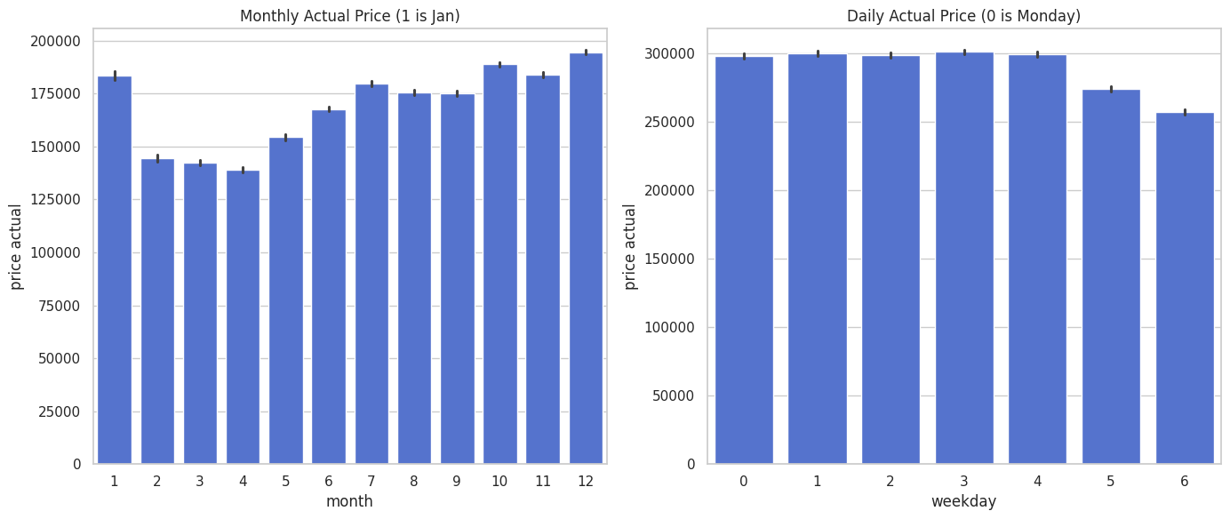
Visualization
The left bar chart displays the average price by month. It shows that the price varies as per the month and depends on various factors.
The right plot shows that average price by weekly manner where as in week days price is high and during weekends price is low.

Slide 8
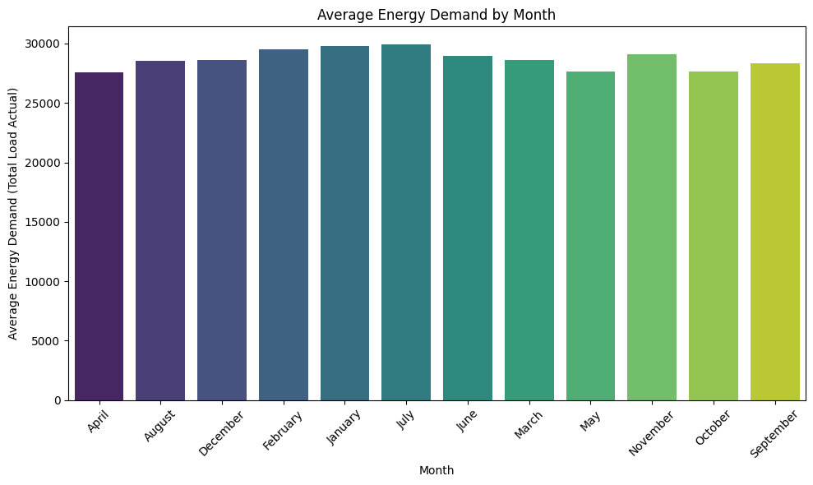
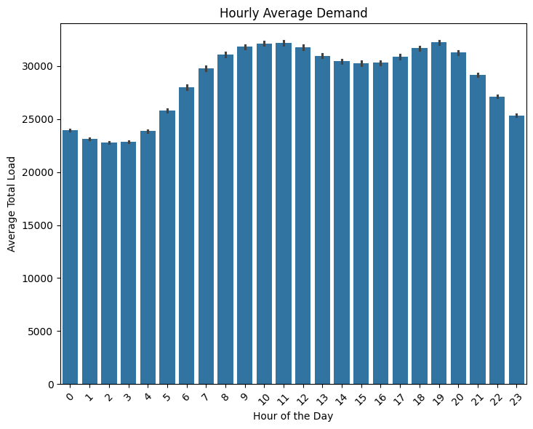
The bar chart displays the average energy demand (Total Load Actual) by month. It shows that the demand is relatively consistent throughout the year
The bar chart shows the hourly average demand
As per the hour of the day which shows load demand is maximum during day time and office hours where as minimum during late night.

Slide 9
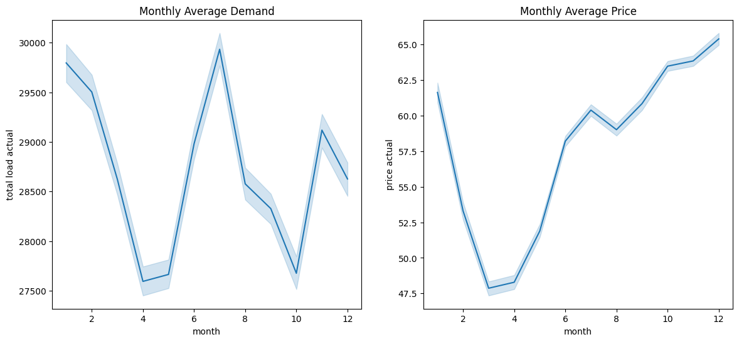
The left plot shows the monthly average demand with a noticeable peak around the middle of the year and another spike near the end of the year
The right plot illustrates the monthly average price, which shows a steady increase throughout the year, peaking in the last months.

Slide 10
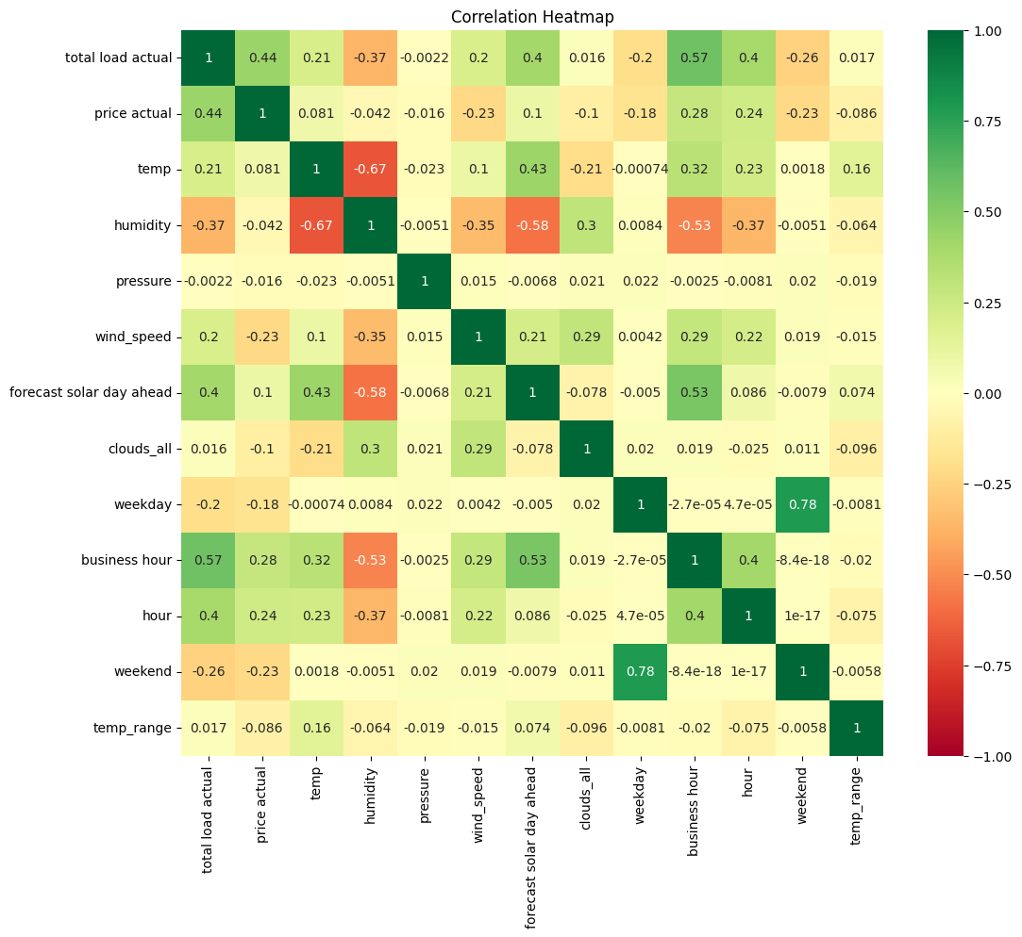
Total Load Actual shows a positive correlation with Business Hour (0.57) and Hour (0.4),
Price Actual is moderately correlated with Total Load Actual (0.44) and Business Hour (0.28),
Temperature has a negative correlation with Humidity (-0.67)
Business Hour is highly correlated with Hour (0.4)

Slide 11
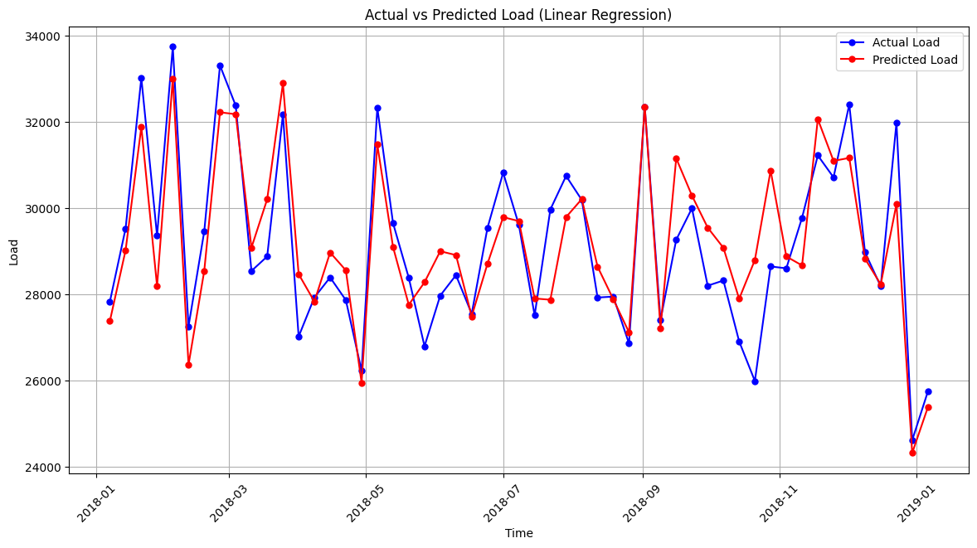
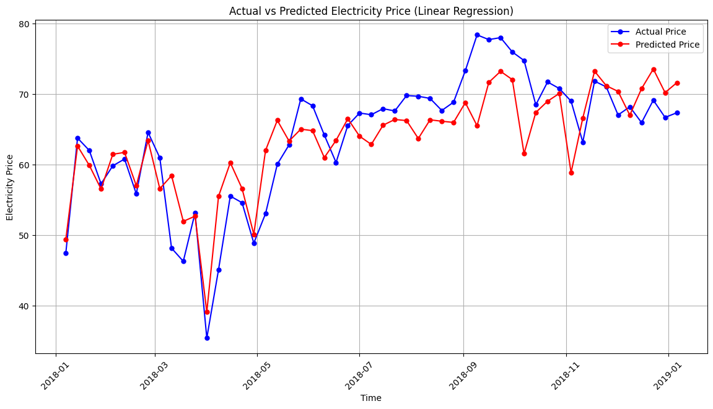
Model Implementation
Linear Regression
Price Actual Prediction:
MSE: 72.67491
RMSE: 8.52495
R^2: 0.6504359
Adjusted R^2: 0.648
MAPE: 0.12604
Total Load Actual Prediction:
MSE: 3424259.6515
RMSE: 1850.4755
R^2: 0.832
Adjusted R^2: 0.831
MAPE: 0.0525

Slide 12
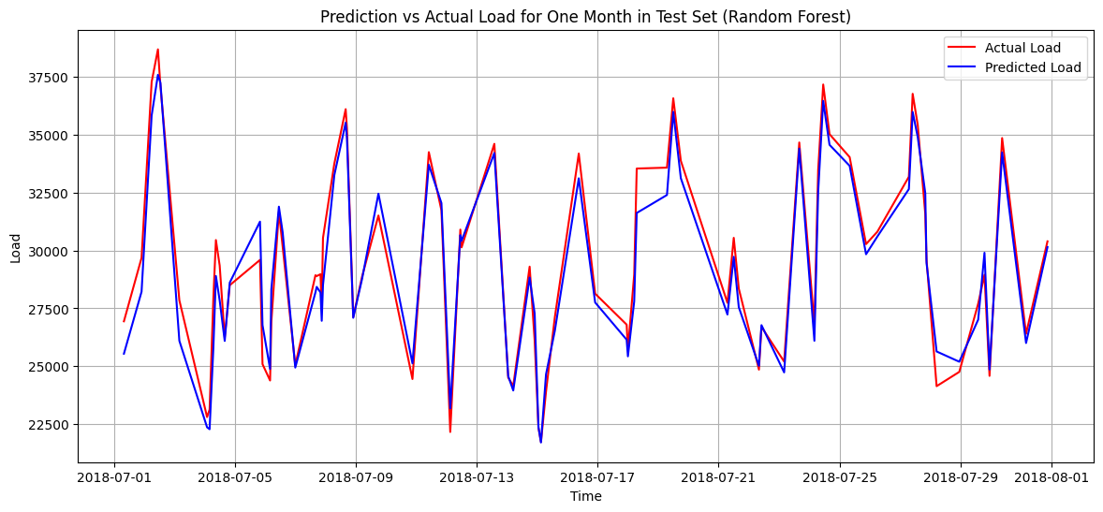
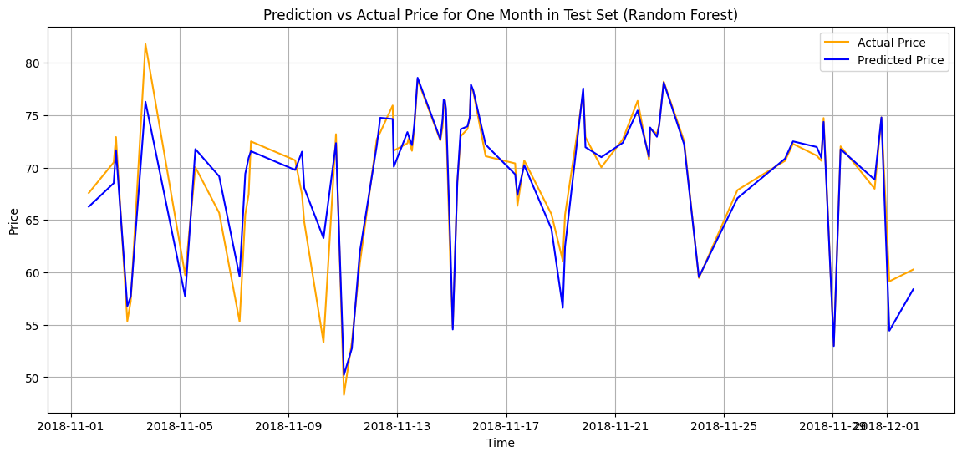
Random forest Algorithm
Price Actual Prediction:
MSE: 13.0598
RMSE: 3.6138
R^2: 0.93718
Adjusted R^2 : 0.9367
MAPE : 0.04757
Total Load Actual Prediction:
MSE : 1019573.590
RMSE : 1009.7393
R^2: 0.950250
Adjusted R^2 : 0.9499
MAPE : 0.02673

Slide 13
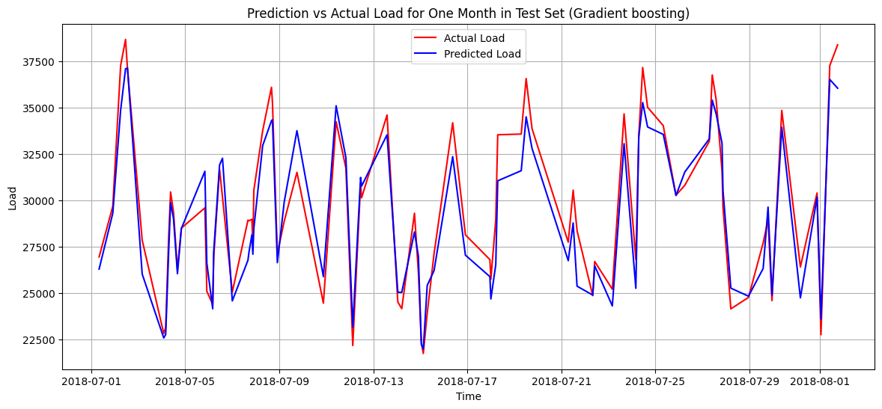
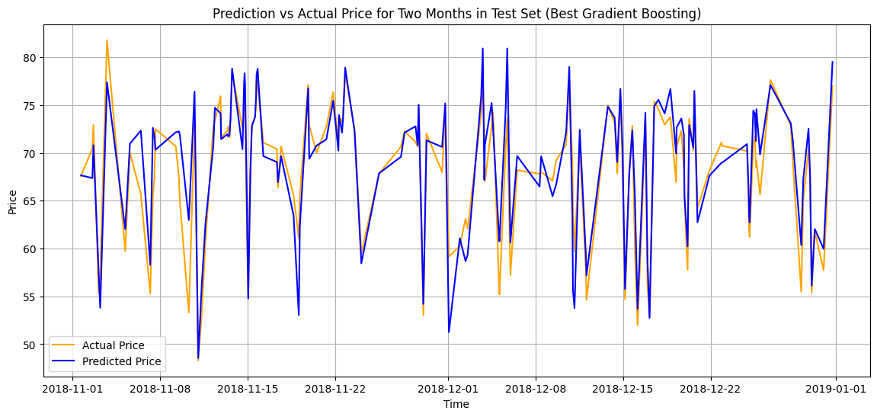
Gradient boosting Regressor
Price Actual Prediction:
MSE : 13.7578800
RMSE : 3.7091617
R^2 : 0.933825
Adjusted R^2 : 0.93336
MAPE : 0.051809
Total Load Actual Prediction:
MSE : 1153222.99942
RMSE : 1073.882209
R^2 : 0.9437290
Adjusted R^2 : 0.943357
MAPE : 0.029599

Slide 14
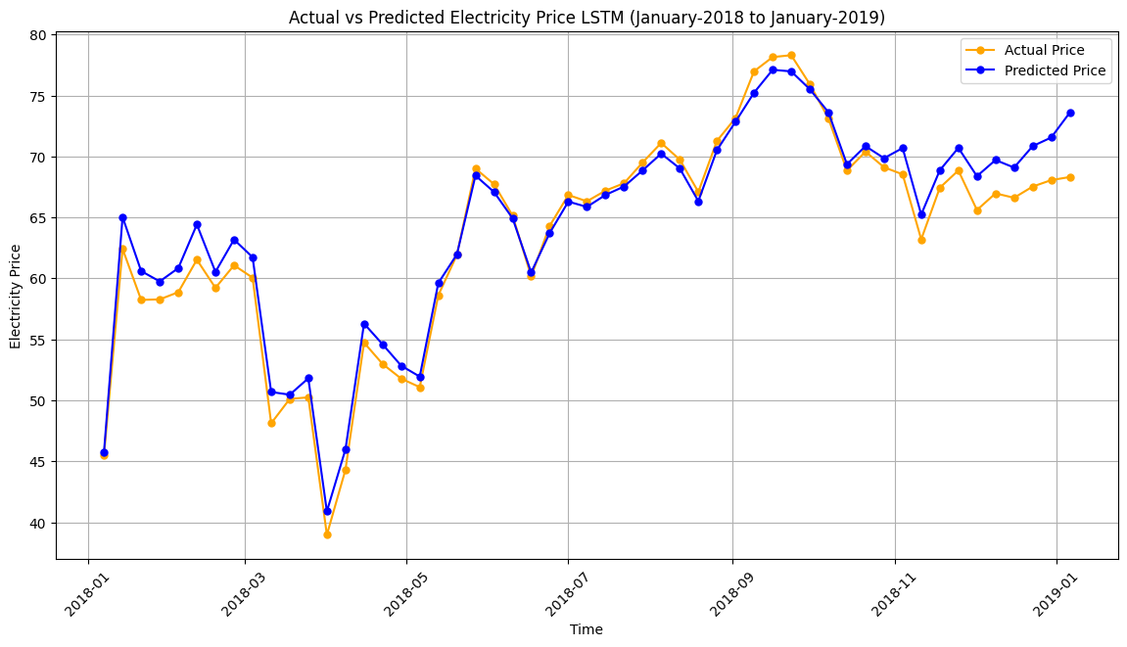
Long short Term Memory (LSTM)
For price Prediction
SEQUENCE_LENGTH = 24
Dropout = 0.3
learning_rate=0.0001
epochs=40
batch_size=32
Price Actual Prediction:
MAE : 2.426148
RMSE : 3.002346
R² : 0.8557
Adjusted R² : 0.85475
MAPE : 0.03565

Slide 15
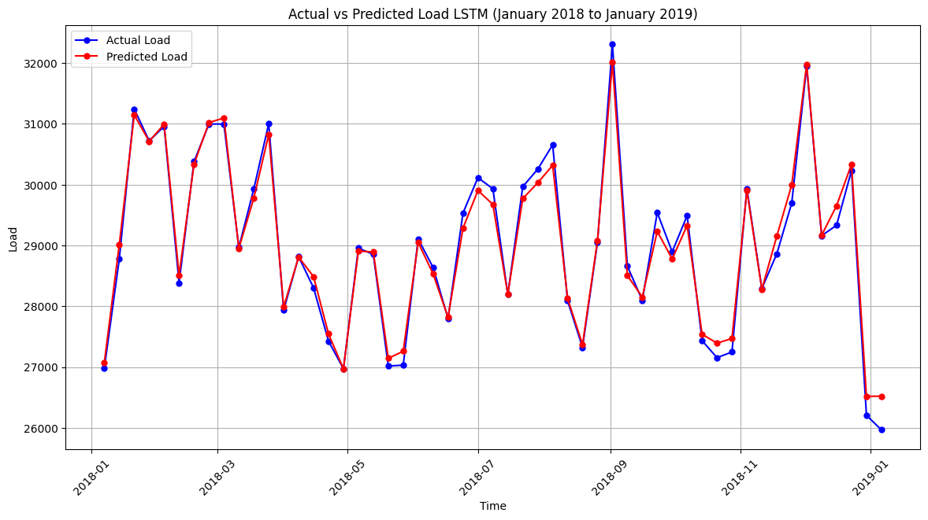
LSTM for Load Prediction
SEQUENCE_LENGTH = 24
Dropout = 0.3
learning_rate=0.0001
epochs=40
batch_size=32
MAE : 517.2379
RMSE :683.33461
R² : 0.977845
Adjusted R² : 0.9776883
MAPE : 0.0180829

Slide 16
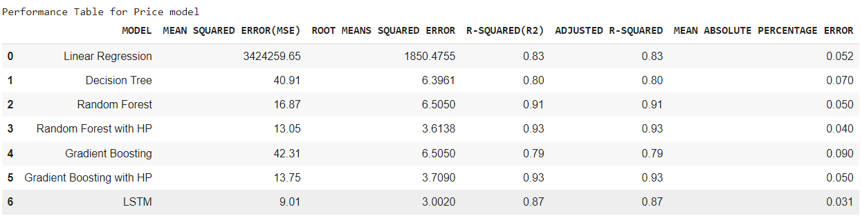
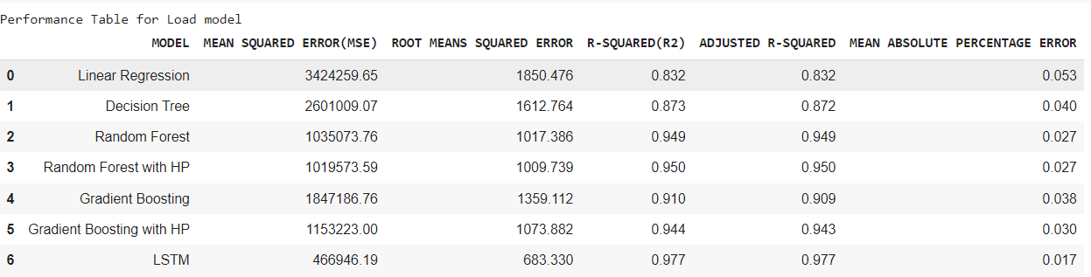
Model Comparison & Selection
For price Forecasting : The LSTM model performed well with good R^2 (0.87) and MAPE (0.031) along with Random forest with Hyper parameter Tunned model also working well with R^2(0.93) and MAPE of 0.040
For Load Forecasting : The LSTM model performed best with the highest R² (0.977) and the lowest MAPE (0.017).

Slide 17
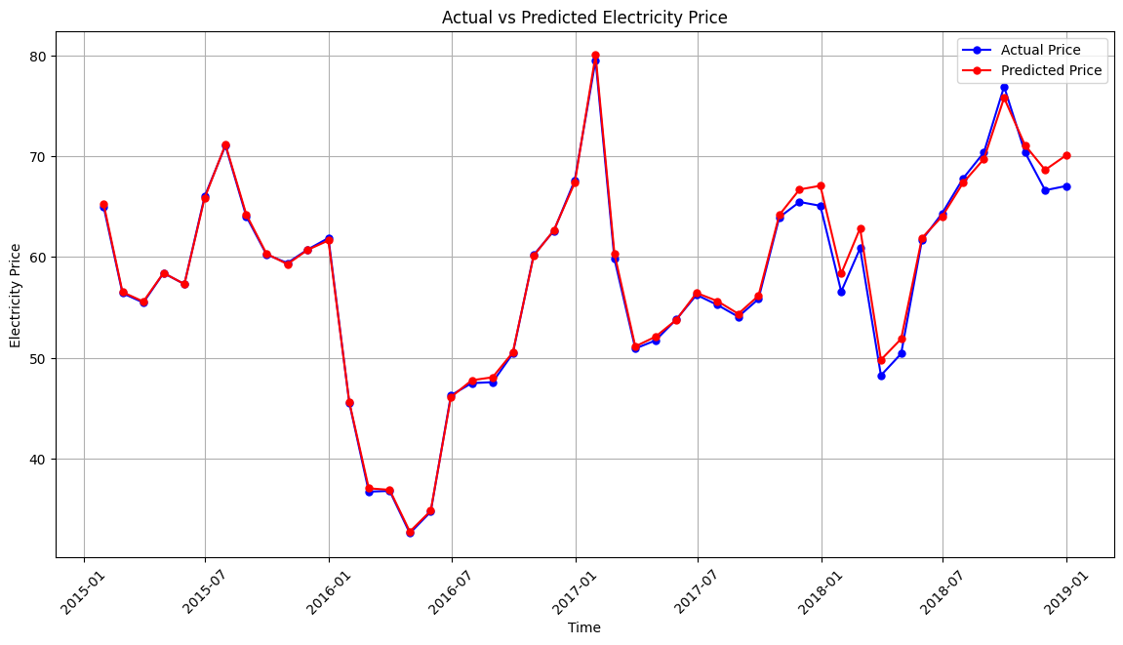
Conclusion
The LSTM model demonstrated superior performance in forecasting electricity demand and prices compared to other models.
By Incorporating advanced feature selection methods, like correlation analysis and model-derived feature importance, enhanced the model's prediction accuracy.

